Slide 1

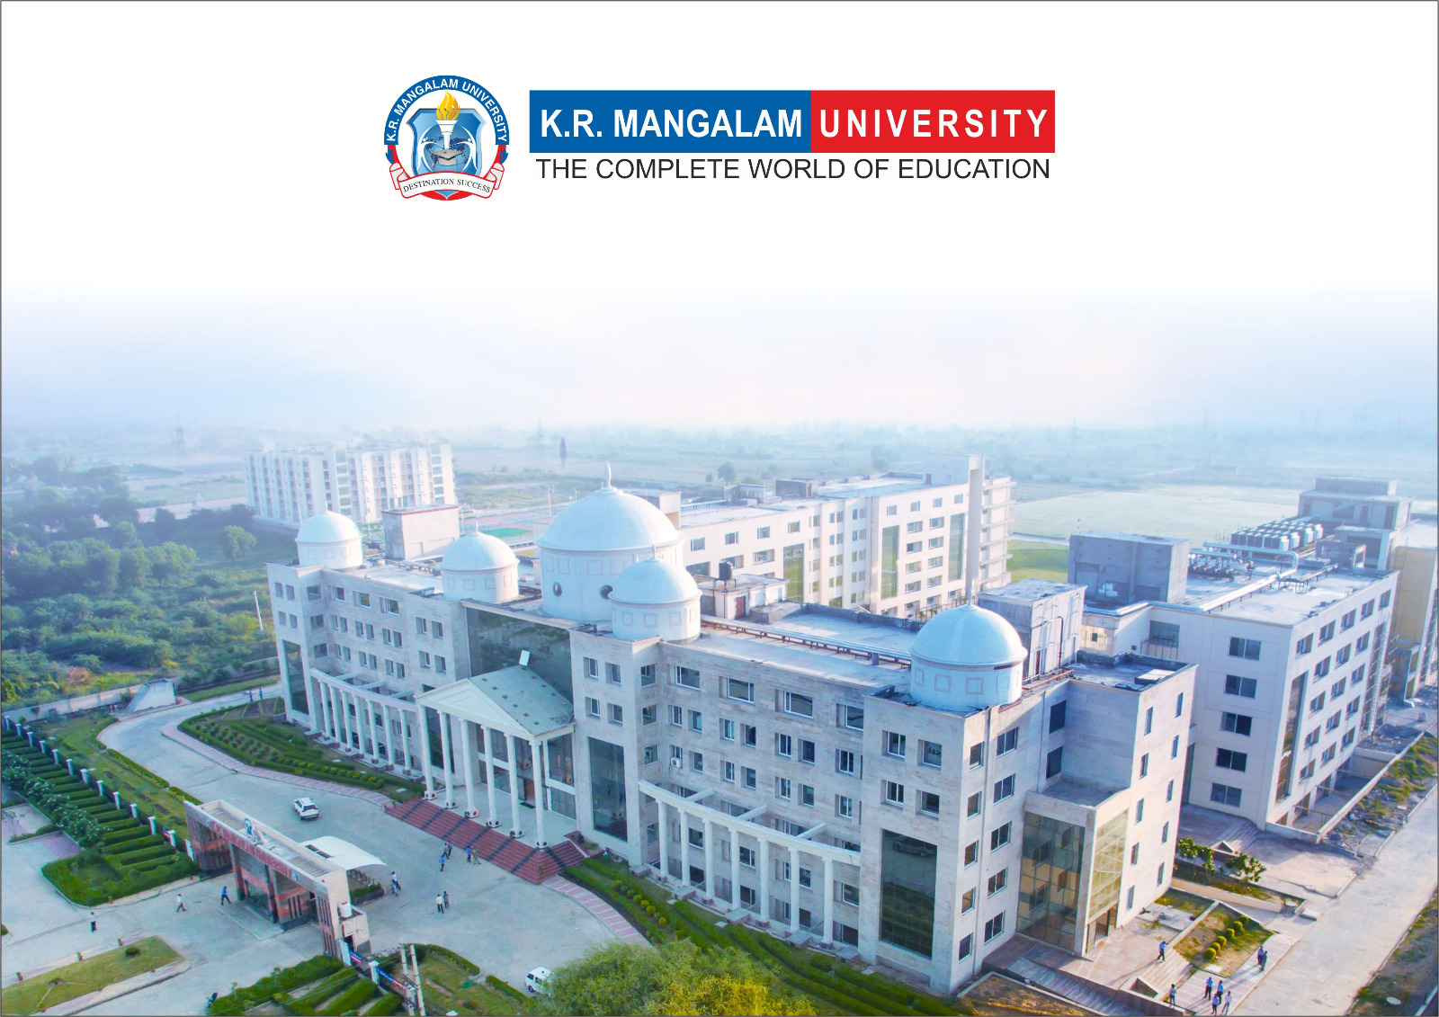
Introduction to Water Chemistry & Hardness
Course Code: ETMLCH104
Course Name: Engineering Chemistry
Program: B.Tech. (AI/ML)
Unit1:Water technology & Chemical Fuels
Dr Pratibha Sharma
Assistant Professor, Department of Chemistry
School of Basic and Applied Sciences
K.R. Mangalam University
Sohna Road, Gurugram

Slide 2

Course Overview
Unit Number: 1 | Title: Water technology | No. of hours: 6
Introduction, water analysis: Hardness-determination by EDTA method, Treatment of boiler feed water: Internal treatment (Phosphate, Colloidal and Calgon conditioning). External treatments: Ion exchange and lime-soda process, Zeolite processes. Boiler scales formation and ill effects, methods of prevention of scales. Numerical problems
Unit Number: 2 | Title: Chemical Fuels | No. of hours: 9
Fuels: Introduction, classification, calorific value (HCV & LCV), Determination of calorific value of fuel using Bomb calorimeter. Solid fuel: Coal- its analysis by proximate and ultimate analysis, Numerical problems. Liquid fuels: Refining of petroleum, Petroleum cracking, Knocking in IC engine, its ill effects and prevention of knocking. Anti-knocking agent: Leaded and unleaded petrol. Gaseous fuels: LPG, CNG and their applications.
Unit Number: 3 | Title: Battery Technology | No. of hours: 10
Introduction - Galvanic cell, electrode potential, EMF of the cell and cell representation. Batteries and their importance, Classification of batteries- primary, secondary and reserve batteries with examples. Battery characteristics - voltage, capacity, energy density, power density, energy efficiency, cycle life and shelf life. Construction, working and applications of: Ni-Cd, and Lithium-ion battery. Working principle of an electric vehicle.
Unit Number: 4 | Title: Polymer | No. of hours: 5
Basic concepts of polymer, Types of polymers, Thermoplastic & thermosetting plastics, Preparation and application of some industrially important polymers (Natural rubber, Buna S, Buna-N, Neoprene, Isoprene, Nylon-6, nylon-6,6 , Decron and Terylene). Conducting and biodegradable polymers.

Slide 3
COURSE OUTCOMES
CO1: Understand the methods for water hardness and the basics of boiler water treatment and analyze fuel calorific values and battery.
CO2: Explain the characteristics and working principles of different battery types and types of fuels.
CO3: Determine the differences between batteries and fuel cells and classify fuel cell types based on their components..
CO4: Identify between hard and soft water, solve the related numerical problems on water purification and emf and its significance in industry and daily life.

Slide 4
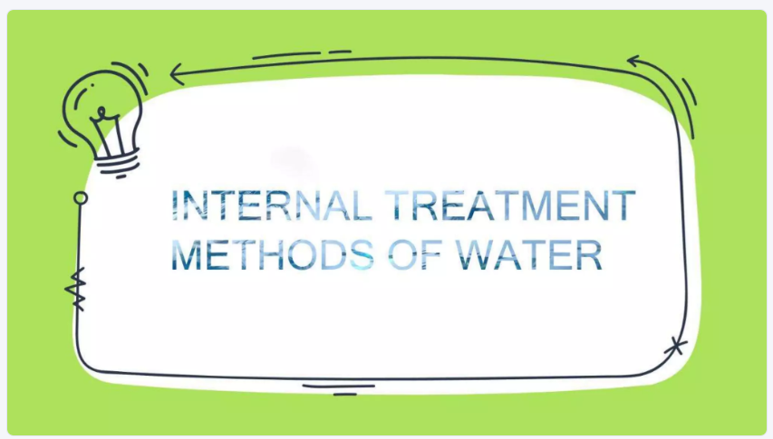

Slide 5

Boiler Trouble
Boilers are used in industries and power station to generate steam. During conversion of water into steam in boiler, the dissolve and suspended solids are not removed. All the impurities are deposited in form of scale and sludge within the boiler and causes boiler troubles.
a) Scales formation:
Scales are hard deposits, which stick on the inner wall of the boiler. These are formed by CaCO₃, CaSO₄, Ca(HCO₃)₂, Mg(OH)₂ etc. in hot portion of boiler.
b) Sludge formation:
Sludge form loose, slimy and soft precipitate in the colder area of the boiler. The sludge formed by the CaCl₂, MgCl₂, MgCO₃, MgSO₄ etc.
Problems caused in boilers:
i) Scales and sludge is poor conductor of heat & therefore prevent effective transfer of heat to water.
ii) In this condition excessive heat is required which increase fuel consumption.
iii) Scale often crack due to their uneven expansion allowing the water to come immediately in contact with overheated metal. This suddenly result in the formation of large quantity of steam which in turn leads to excess pressure and then to explosion.

Slide 6
Problems caused in boilers:
i) Scales and sludge is poor conductor of heat & therefore prevent effective transfer of heat to water.
ii) In this condition excessive heat is required which increase fuel consumption.
iii) Scale often crack due to their uneven expansion allowing the water to come immediately in contact with overheated metal. This suddenly result in the formation of large quantity of steam which in turn leads to excess pressure and then to explosion.

Slide 7
WATER SOFTENING
The process whereby we remove or reduce the hardness of water is termed as softening of water. It is very essential process since hard water is unsuitable for domestic as well as industrial use.
The hardness causing salts can be removed from water by following two ways.
a. Internal treatment: The internal treatment of boiler feed water refers to the conditioning of water in the boiler itself by the addition of chemicals. The following conditioning methods are used in the internal treatment. Colloidal, phosphate, calgon and carbonate conditioning
b. External treatment: The external treatment of water is carried out before its entry in to the boiler. This treatment prevents boiler problems. It can be done by lime soda process, zeolite or ion exchange process.

Slide 8
Methods to remove the hardness of water
Temporary hardness removal methods:
1. Boiling of Water:
Calcium carbonate which is slightly soluble in water present in the form Calcium bicarbonate because, it easily dissolves in water containing CO₂.
Ca(HCO₃)₂ + Heat CaCO₃ + CO₂ + H₂O
2. Addition of Lime (CaO):
Hydrated lime [Ca(OH)₂] is added to water:
MgCO₃ + Ca(OH)₂ Mg(OH)₂ + CaCO₃
Mg(HCO₃)₂ + Ca(OH)₂ Ca(HCO₃)₂ + Mg(OH)₂
Ca(HCO₃)₂ + Ca(OH)₂ 2CaCO₃ + 2H₂O
Suitable only for Temporary hardness removal process.

Slide 9
Methods to remove the hardness of water
3. Adding sodium carbonate (washing soda):
The calcium or magnesium ions are removed
𝐶𝑎(𝐻𝐶𝑂₃)₂(𝑎𝑞) + 𝑁𝑎₂𝐶𝑂₃(𝑎𝑞) → 2𝑁𝑎𝐻𝐶𝑂₃(𝑎𝑞) + 𝐶𝑎𝐶𝑂₃(𝑠)
4. Addition of aqueous ammonia
The soluble hydrogen carbonates are converted into insoluble carbonates. This enables magnesium and calcium ions to be removed from wate. i.e;
2NH₄OH(aq) + Mg(HCO₃)₂(aq) MgCO₃(s) + (NH₄)₂CO₃(aq) + H₂O(l)

Slide 10
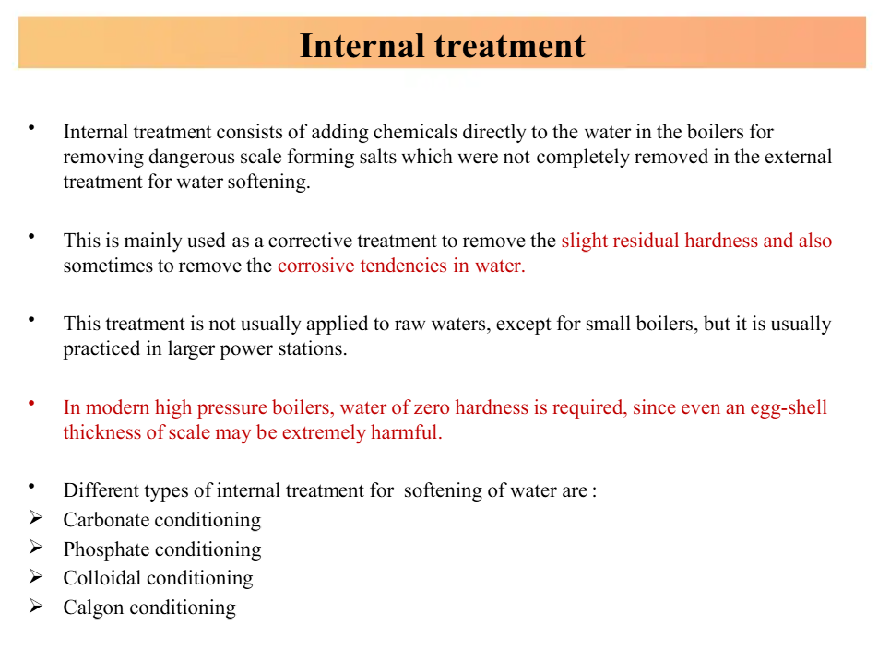

Slide 11
Boiler Trouble removal by internal treatment
Internal treatment:
i) Sludge formation can be removed by blow down operation. In this case impurities can be removed by an outlet present at the bottom of boiler.
ii) Scale formation can be prevented by internal treatment that involve addition of chemical to the boiler water either to ppt the scale forming impurities in the form of sludge so that they can be removed by blow down method or to convert them into soluble compounds.
b) Phosphate treatment:
Scale formation can be removed by adding sodium phosphate, which reacts with hardness of water and form soft sludge of Ca and Mg phosphates which can be removed by blow-down operation.
3CaCl₂ + 2Na₃PO₄ Ca₃(PO₄)₂↓ + 6NaCl
MgSO₄ + 2Na₃PO₄ Mg₃(PO₄)₂↓ + 3Na₂SO₄

Slide 12
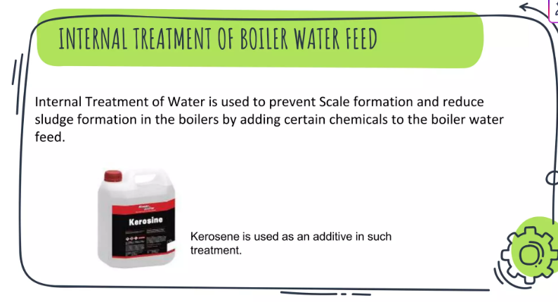

Slide 13
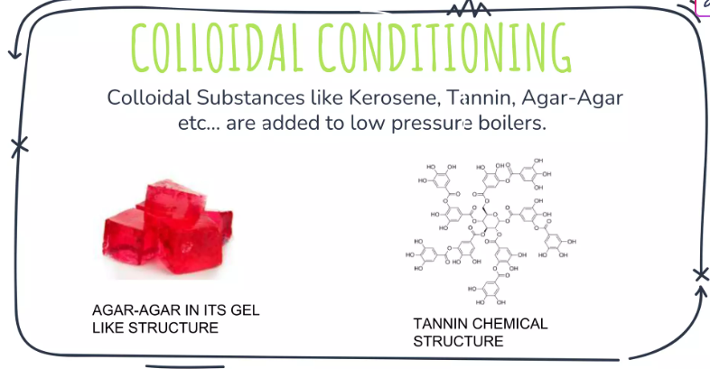

Slide 14
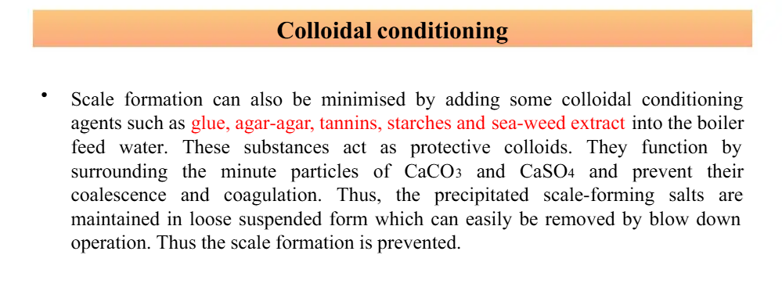

Slide 15
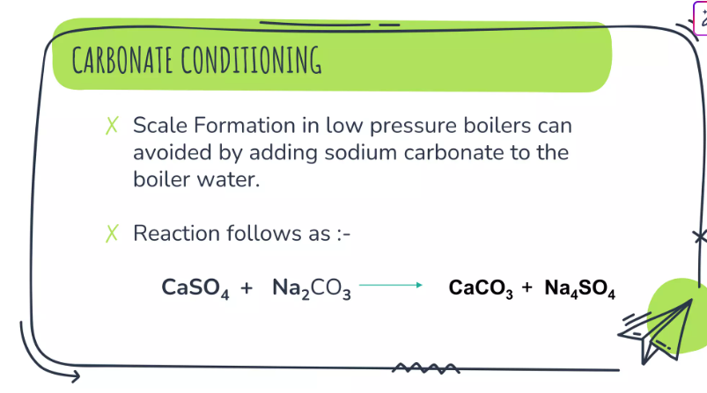

Slide 16
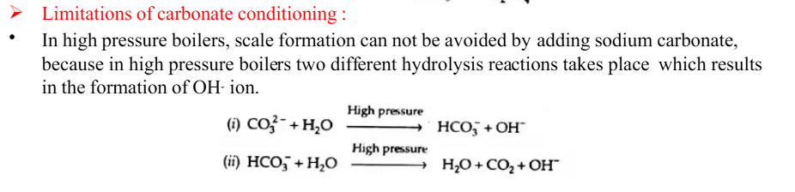
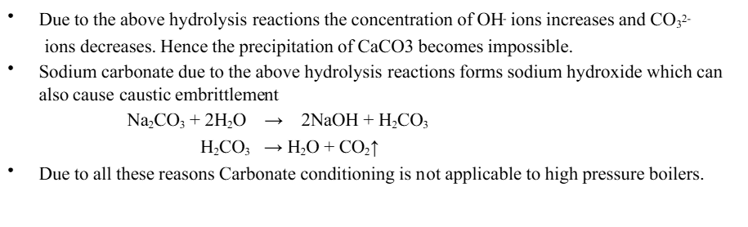

Slide 17
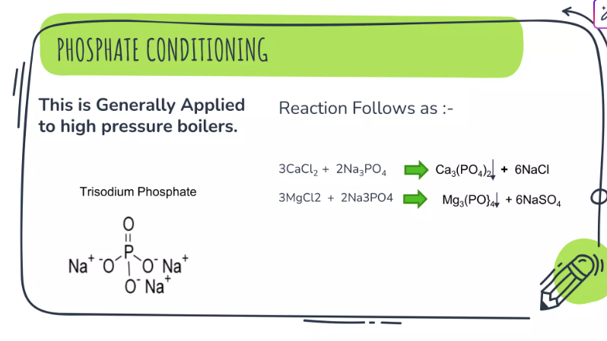
Scale formation can be removed by adding sodium phosphate, which reacts with hardness of water and form soft sludge of Ca and Mg phosphates which can be removed by blow-down operation.​
3CaCl₂ + 2Na₃PO₄ Ca₃(PO₄)₂↓ + 6NaCl​
MgSO₄ + 2Na₃PO₄ Mg₃(PO₄)₂↓ + 3Na₂SO₄

Slide 18
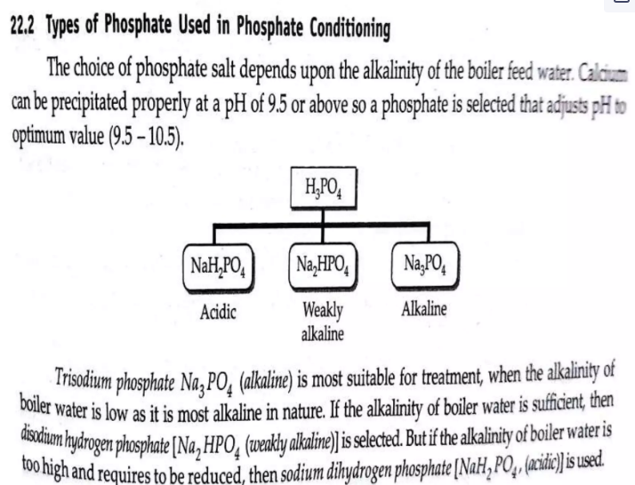

Slide 19
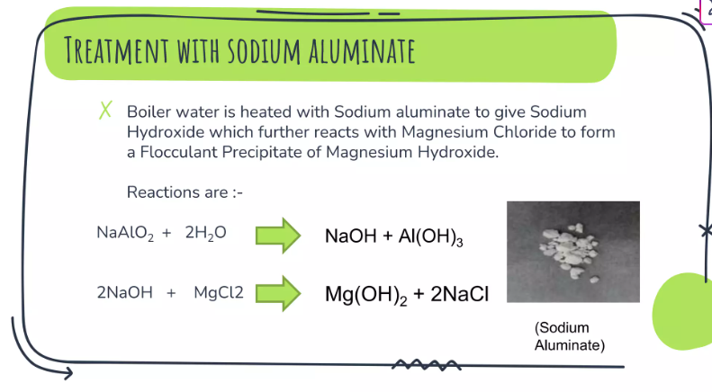

Slide 20
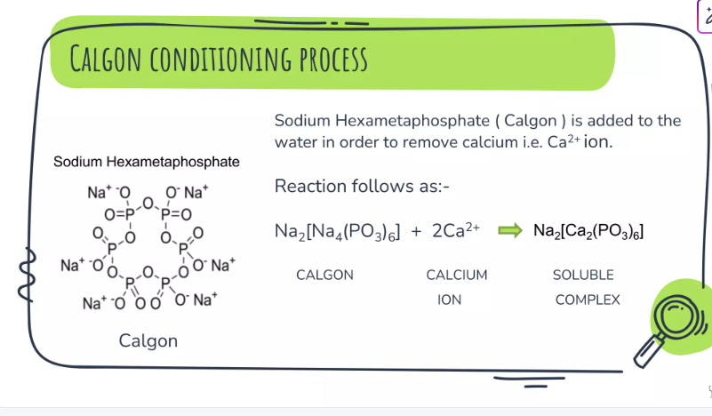
Calgon is sodium meta hexaphoaphate, which can be used to covert CaSO4 into​ soluble complex.​
Na₂[Na₄(PO₃)₆] + 2CaSO₄ Na₂[Ca₂(PO₃)₆] + 2Na₂SO₄​
Calgon soluble​

Slide 21
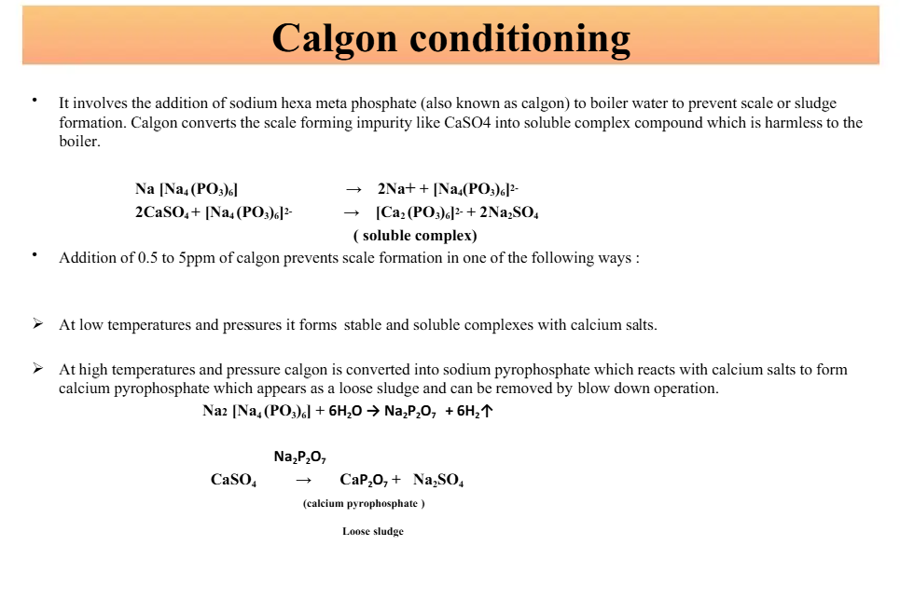

Slide 22
Take away of the session
Purpose: Treats boiler water inside the boiler to prevent scale, corrosion, and carryover.
Method: Chemicals are added directly to boiler water to react with impurities.
Common Treatments:
Phosphate conditioning – Prevents scale by forming soft sludge.
Calgon conditioning – Prevents scale by forming soluble complexes.
Carbonate and sodium aluminate conditioning – Converts scale-forming salts into sludge.
Sludge Removal: Soft sludge formed is removed by blowdown operation.
Benefits: Controls pH, prevents scale/corrosion, increases boiler efficiency.

Slide 23
Questions
What is the main purpose of internal treatment in boiler water? A. Remove suspended solids B. Prevent scale and corrosion inside the boiler C. Remove oil and grease D. Reduce turbidity
Which chemical is used in phosphate conditioning? A. Na₂CO₃ B. Na₃PO₄ C. NaCl D. H₂SO₄
What is the function of Calgon in internal treatment? A. Disinfect water B. Form soluble complexes with calcium C. Lower water temperature D. Remove dissolved gases
How is the sludge formed in internal treatment removed from the boiler? A. Filtration B. Neutralization C. Blowdown operation D. Aeration
Which of the following is not an internal treatment method? A. Phosphate conditioning B. Zeolite softening C. Calgon conditioning D Carbonate conditioning

Slide 24
References
Engineering Chemistry by Jain and Jain.
Internal Methods of Water treatment | PPTX | Chemistry | Science

